Slide 1
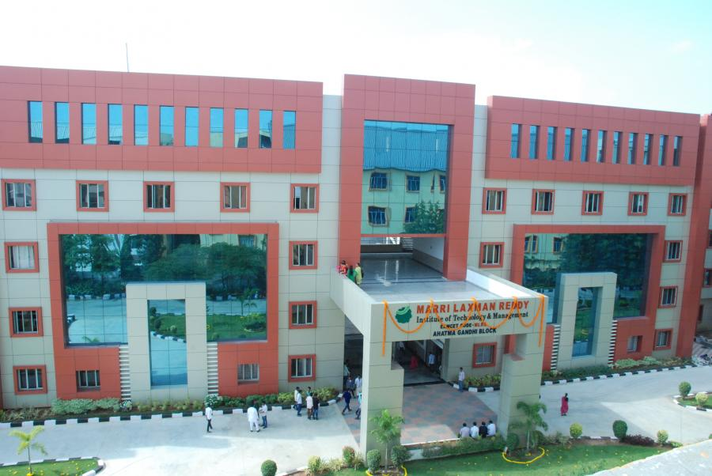
MLRITM RESULTS

Slide 2
CONTENTS
Student Login
Staff Login
Admin Login

Slide 3

MLRITM RESULTS
STUDENT LOGIN
USER ID :--
PASS KEY:--
Note: These given credentials are original, you can use this credentials to access this student login to check the project is working or not .
137y1a0586
137y1a0586

Slide 4
STUDENT LOGIN
After Login you can Access following..
Student can see their results
Student can request for results, when they are updated , he will get results to his mobile number.
The student can edit his profile

Slide 5
MLRITM RESULTS
ADMIN LOGIN
USER ID :--
PASS KEY:--
Note: These given credentials are original, you can use this credentials to access this Admin login to check the project is working or not
137y1a0580
137y1a0580

Slide 6
ADMIN LOGIN
After Login you will have following access..
Admin can add new student
Admin can add new staff
Admin can also add new admin
Admin can edit both staff and student profiles
He will upload results up-to-date

Slide 7
MLRITM RESULTS
STAFF LOGIN
USER ID :--
PASS KEY:--
Note: These given credentials are original, you can use this credentials to access this Staff login to check the project is working or not
137y1a0523
137y1a0523

Slide 8
STAFF LOGIN
After Login you can see following access..
Faculty can edit his profile
He can upload internal marks
He can see the results of their students

Slide 9
Uses
By this project we can get results instantly Without any connection problems and these results will get through mobile number.

Slide 10
NOTE:
In the above Slides the all Given Credentials are the Original one.
Since this is an Authorized site we have already provided all details in database.
So, use those credentials to check the Project.

Slide 11
THANk YOU
Project By:
M. Sai Kumar Reddy
K. Vishwa Mahith
P. Sai Nihar

